Slide 1


The Role of RCDs in
Tackling Climate Change
CARCD 2020 Virtual Conference
November 16, 2020
Linda G. Brown

Slide 2


Conservation
Healthy soils
Carbon farm plans
Reduced methane from dairy
Sustainable water management
Sustainable forest management
Lower emissions equipment
Erosion management
Wetlands restoration
Riparian restoration
Native tree planting
Urban greening
California
RCDs
Stewardship
Notes:
I don’t need to convince you that climate change is a real and present danger.
CLICK
You know better than anyone that the many programs that NAPA RCD has pioneered - programs that benefit the community and environment in so many ways
CLICK
Are also helping to lead the fight against climate change locally.

Slide 3
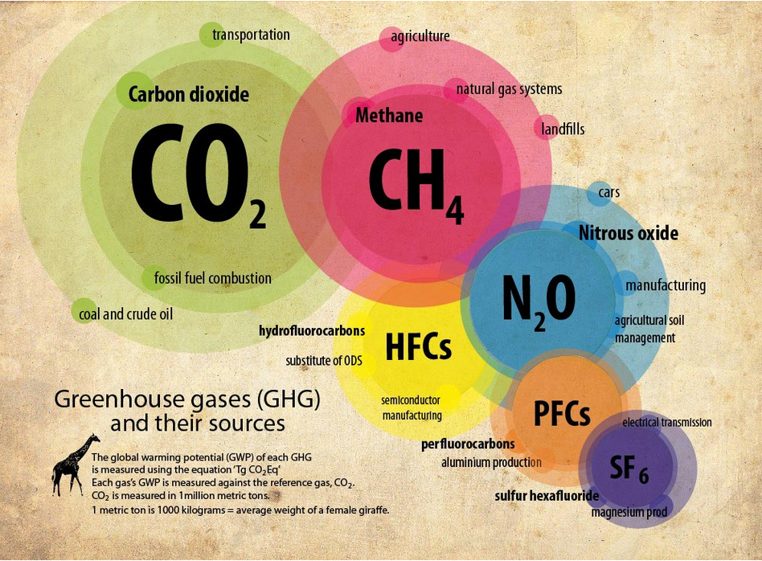
Your work directly impacts …

Slide 4
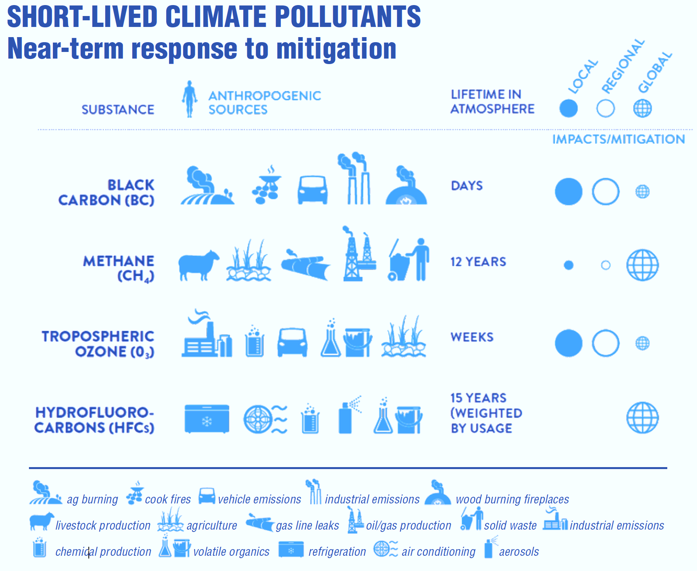
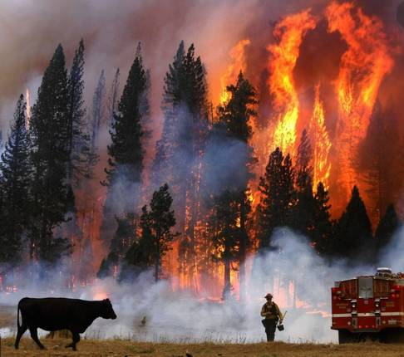
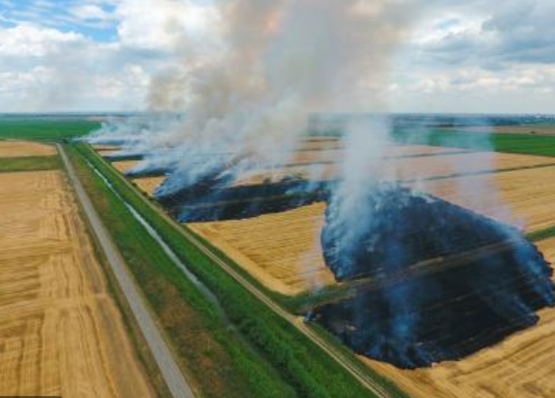

and …
Source:

Slide 5
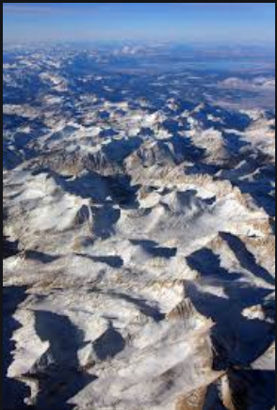
and changes in albedo …
Measured black carbon deposition on the Sierra Nevada snow pack and implication for snow pack retreat
(Atmos. Chem. & Physics, 2010)
Large-scale deposition in Sierra Nevada… as much as 1/3 likely transported from Asia.
Sources:
https://www.researchgate.net/publication/45658319_Measured_black_carbon_deposition_on_the_Sierra_Nevada_snow_pack_and_implication_for_snow_pack_retreat

Slide 6
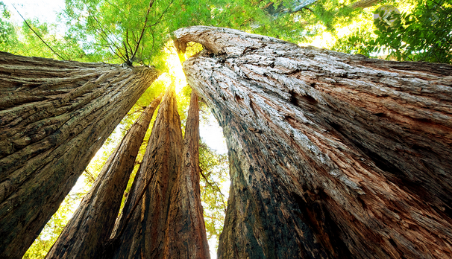
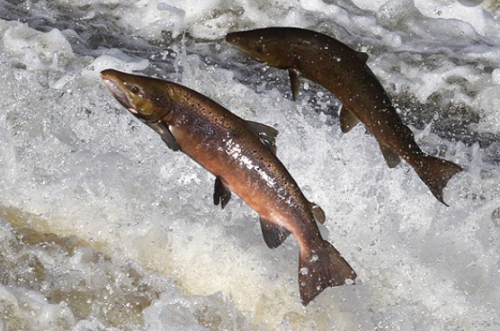
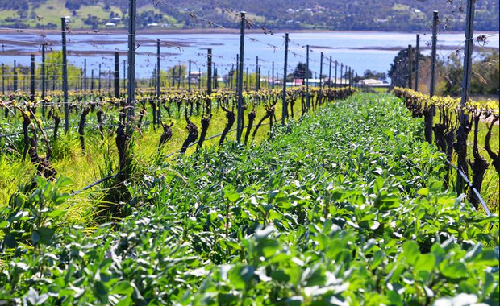
… while building in greater resilience.

Slide 7
The underlying driver of climate change

Slide 8
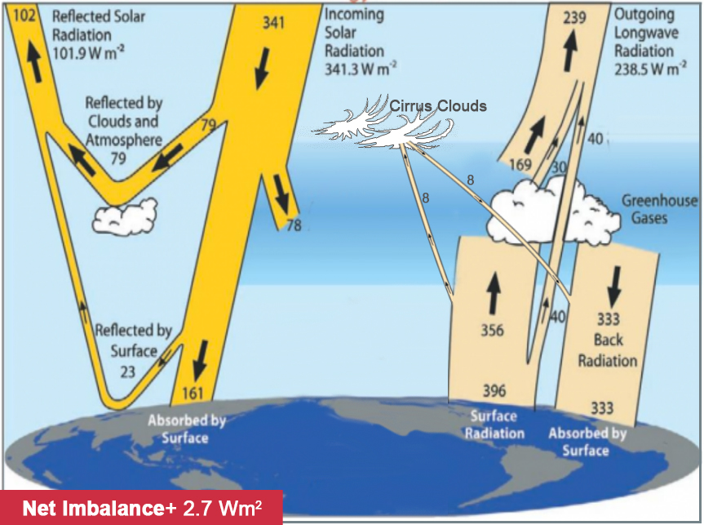
Climate Change:
A shift in the Earth’s energy balance
W/m² is the measures of “Radiative Forcing” – the extent to which the earth is heated (positive RF) or cooled (negative RF)

Slide 9
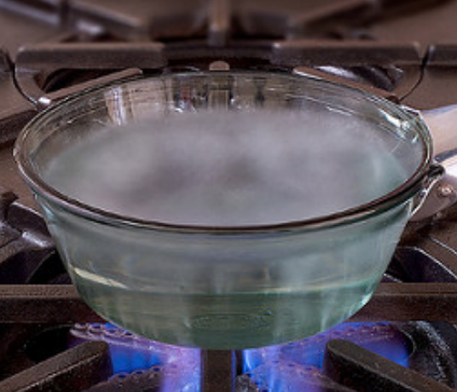
Radiative Forcing (RF):
Leading indicator of climate change
CAUSE – EFFECT
The more excess heat is trapped, the more:
climate will be disrupted
environmental damage will occur
temperature will rise

Slide 10
Passing dangerous thresholds
Excess Heat Excess Temperature
(Radiative Forcing)
⁺1.9 W/m² → ⁺1.5ºC
2002
⁺2.7 W/m² → ⁺2.0ºC
2017
IPCC Special Report (2018): +1.5ºC as early as 2030!
Notes:
INTERACTIVE: Show of hands - have we passed this threshold yet?

Slide 11
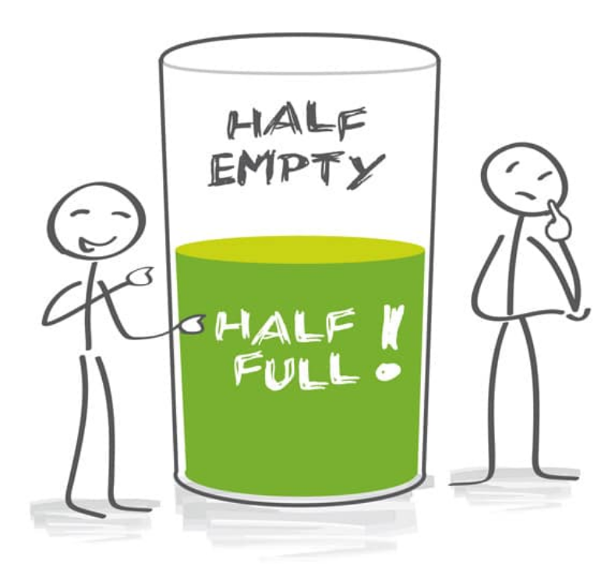
The Bad News
We have a LONG WAY to go!
The Good News
By focusing on reducing the excess heat (RF), we can get ahead of the problem:
WHAT we need to accomplish
WHEN we need to do it, and
HOW we can get the fastest, most effective results.

Slide 12
Stabilizing RF requires strategies that deliver in the near-term
Reduce 1.4 W/m²
Reduce 5.7 W/m²
Reduce 4.3 W/m²
Reduce 2.8 W/m²
Climate Sustainability

Slide 13
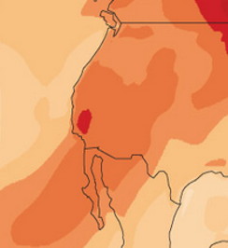
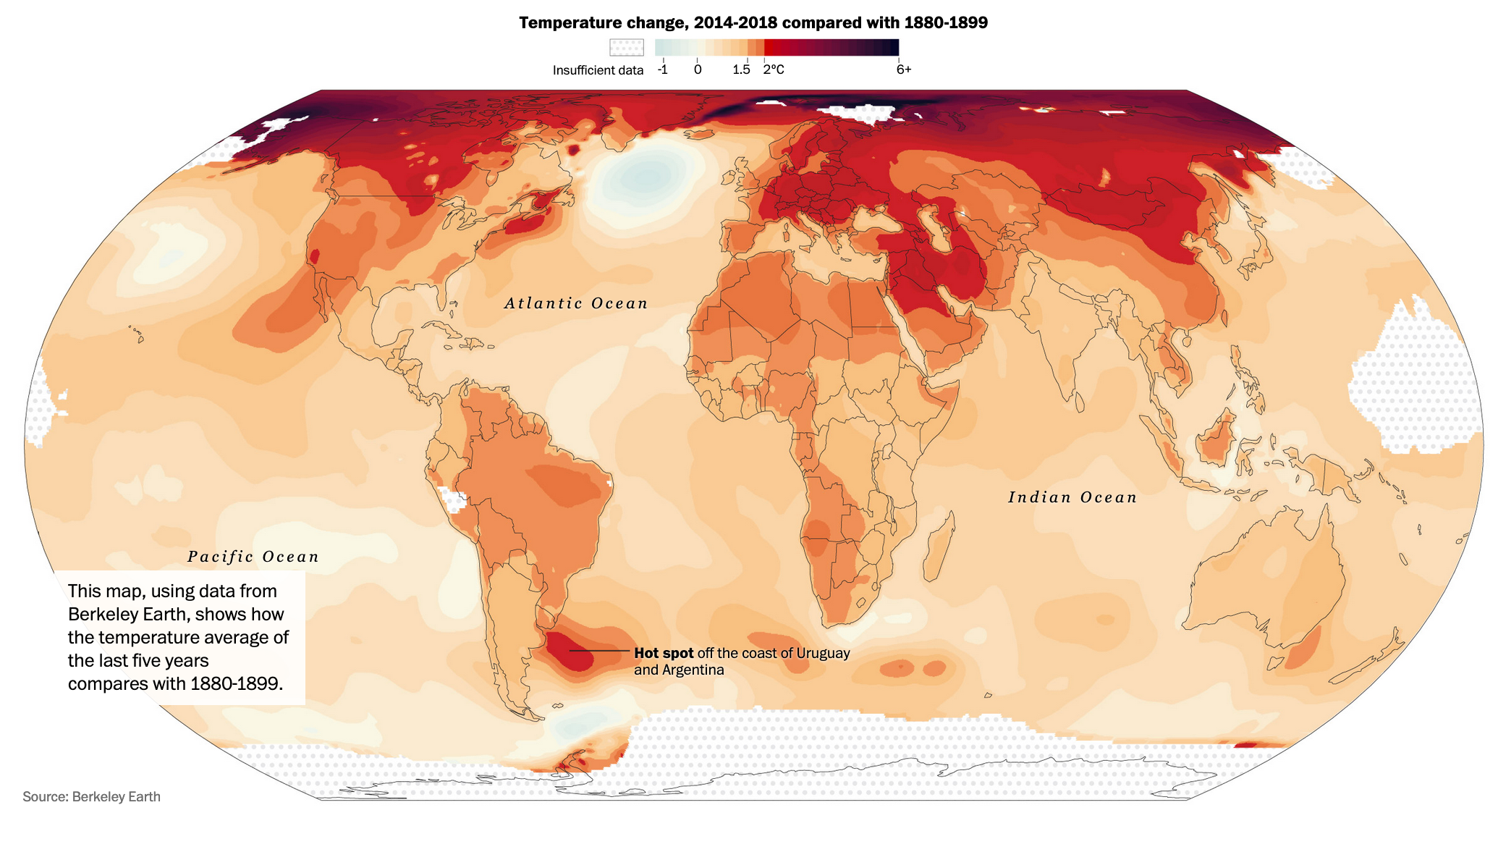
Some regions are at
especially high risk in the near term

Slide 14
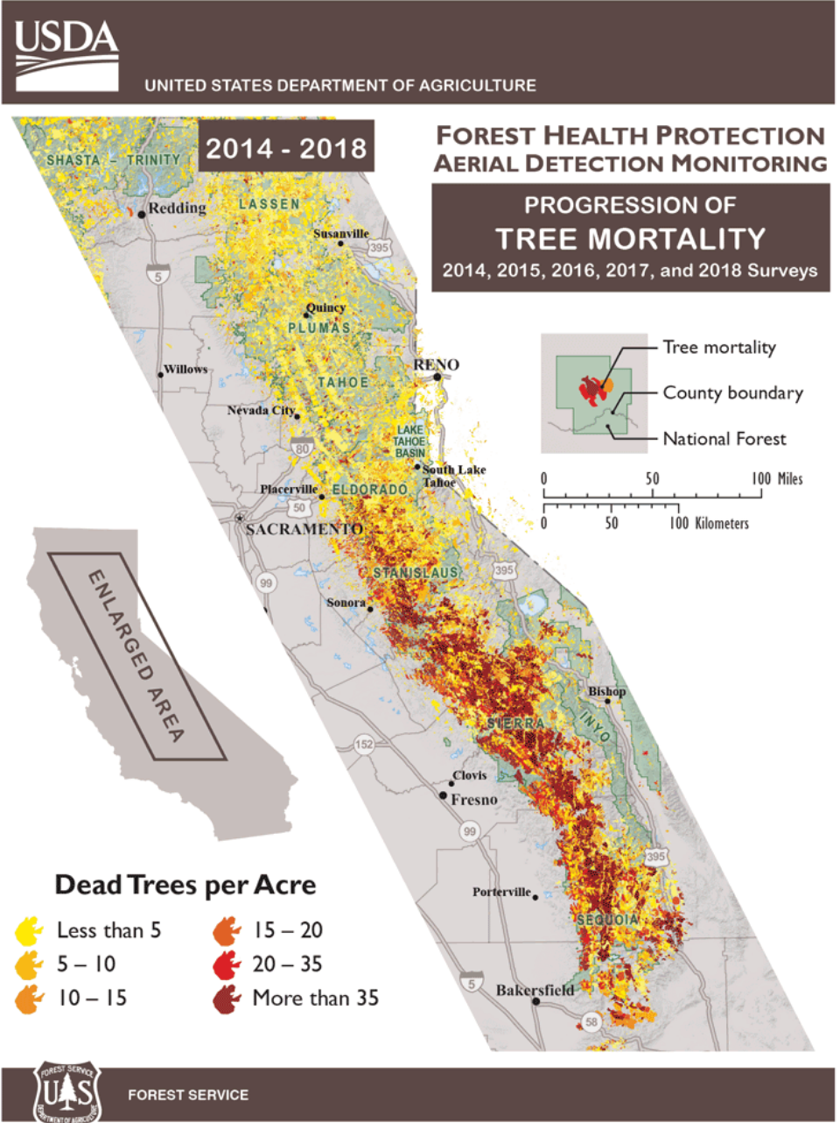
California can’t wait
California is already experiencing temperatures 2°C to 3°C above normal,
spiking far higher!
→
5°F
• 129+ million trees (2010-2018) lost to drought, bark beetle, etc.
• 4.1 million acres burned so far (2020)

Slide 15
Prioritizing California RCD Initiatives from a Climate Perspective

Slide 16
The importance of an RF-based approach to climate change going forward
Comprehensive
Full range of long-lived and short-lived climate pollutants (GHGs, aerosols, and particulates) that influence climate, positively or negatively
Fully values methane’s impact: 150x CO2 during first year of emission
Non-emission factors that affect climate (e.g., reduced albedo on snow and ice, and changes to other land surfaces)
Legacy emissions - The fraction of past emissions of GHGs still present in the atmosphere that are contributing to current-day RF levels
Strategic
Can be used to identify strategies to stabilize RF within the next decade, in order to stabilize and restore climate in the decades that follow.
Opens the door to a wider range of mitigation options that can be implemented cost-effectively.
Includes essential precautionary environmental and human health screening to pre-assess projects for potential climate benefits, co-benefits, and adverse trade-offs

Slide 17
Country RF Climate Footprints
RF Climate Footprints
Annual GWP-100 Footprint
Account for only a fraction of global RF
Short-term strategies
Longer-term strategies
130 Countries

Slide 18
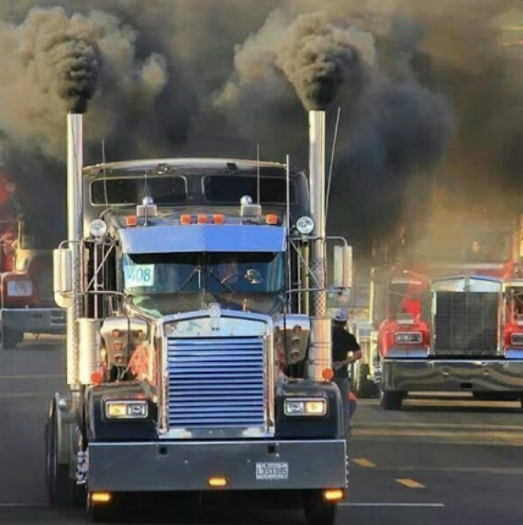
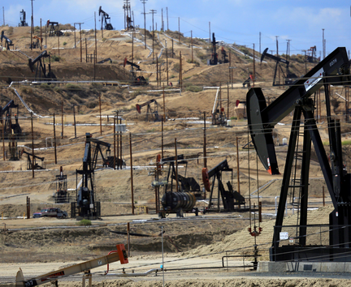
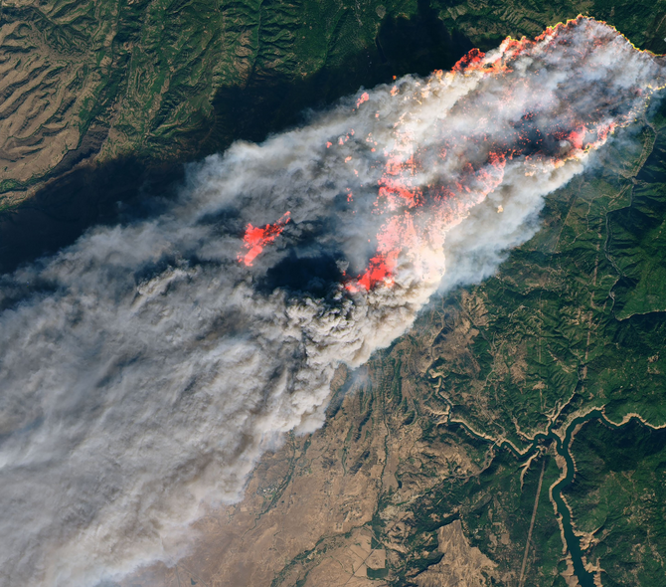
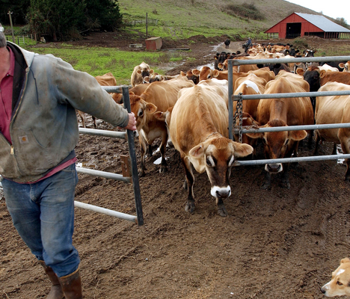
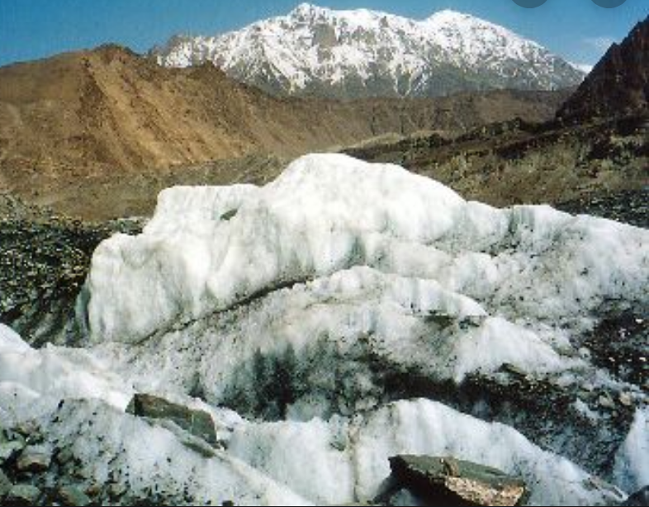
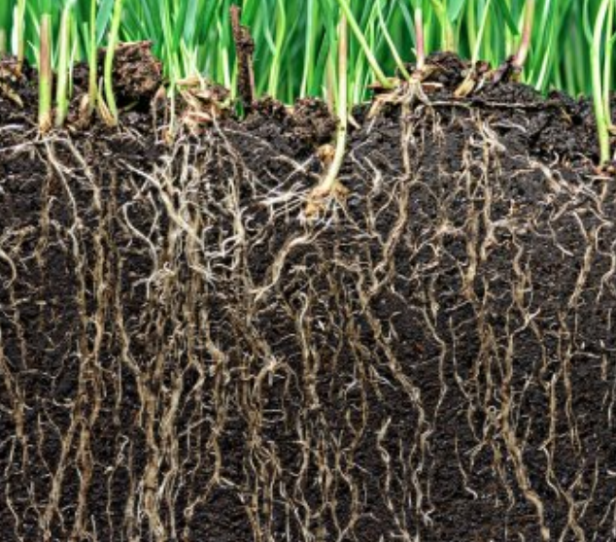
Sources of RF
Greenhouse gas emissions
Short-lived climate forcers
Changes in albedo
Reduced carbon sequestration

Slide 19
Strategic Plan
Identify top short-term and long-term RF reduction projects
Consider new budget constraints and co-benefits
Identifying community partners – electeds, industry leaders, NGOs
Deliver the message
Taking a leadership role
Local RCD
------------------
Climate Steps

Slide 20
climate
The future of a resilient California starts here…
and now!
linda@350bayarea.org

